Slide 1

Bank Climate Risk RAG System
Cross-Firm Analysis of Climate-Related Risk Disclosures in G-SIB Sustainability Reports
TEAM MEMBERS
Cecilia Li
Fangyuan Lu
Isis Hernandez Moreno
Jiahui Han

Slide 2






USE CASE: VALUE ADDED
Query-Driven Disclosure Analytics for Cross-Firm Climate Risk Insights
Dynamic Querying
Standardized Classification
SDG-Linked Analysis
Analysts can ask any regulatory question. The system adapts to shifting priorities without requiring new static reports.
Automatically classifies disclosures into standardized risk categories (Transition vs. Physical) regardless of phrasing.
Associates risk narratives directly with firms' self-declared SDG alignment, enabling accountability checks.
Transparency & Traceability
Cross-Firm Comparability
Every output includes direct citations from source documents, ensuring results are auditable and evidence-based.
Generates structured table outputs that allow side-by-side comparison across multiple G-SIB institutions.

Slide 3


NON-TRIVIALITY
WHY EXISTING APPROACHES FALL SHORT
Manual Reading
Extremely time-consuming; inconsistent across analysts; not scalable to 10+ firms.
Keyword Search
Cannot distinguish risk type from context; misses paraphrased or implicit disclosures.
Query-Driven Analytical Tool
Pre-indexed documents, structured outputs, and source traceability.
Standalone Generative AI
Struggles with long or multiple PDFs; may miss specific numeric disclosures; produces long narrative outputs.
Conclusion: A structured retrieval workflow improves focus, traceability, and cross-firm comparability.

Slide 4

NON-TRIVIALITY
Combining Search Discipline with LLM Flexibility
Turning heterogeneous disclosure language into consistent structured outputs.
Retrieval Before Generation
Contextual SDG Interpretation
The system indexes the full disclosure corpus in advance and retrieves relevant passages before generating responses.
This reduces missed numeric disclosures and cross-bank confusion.
Recognizes SDG alignment from narrative context while distinguishing explicit references from inferred ones.
-Transition and physical risks are described using institution-specific phrasing
-SDG alignment is sometimes implicit rather than explicitly labeled
-Important disclosures may appear outside expected sections
Context-aware Risk Classification
Structured Concise Outputs
Identifies transition vs. physical risks (e.g., "policy shifts" vs. "flood events") regardless of the exact terminology used.
Returns short, comparable findings:
Risk type • Key metrics • SDG linkage • Source document
BEYOND A BASIC WRAPPER
Document Preprocessing
+
Vector Retrieval
+
Metadata Filtering
+
Constrained Reasoning

Slide 5
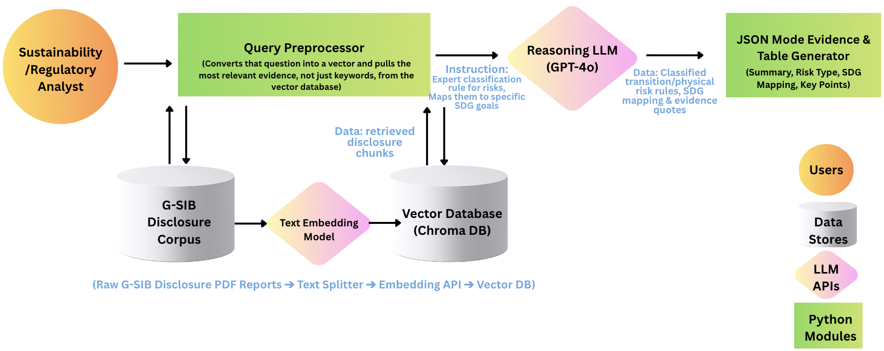
ARCHITECTURE OVERVIEW
Application Architecture Diagram: RAG Pipeline
Our data starts as raw G-SIB Disclosure PDF reports.
We use PyPDF2 to extract text and a sliding-window splitter to create 400-word’ chunks.
Each chunk is converted into a numerical vector using OpenAI’s text-embedding-3-small model.
These vectors are stored in Chroma DB, a local vector database.

